Slide 1
Essential HTML
02
I399 Web Development

Slide 2
HTML
From Wikipedia, the free encyclopedia
HyperText Markup Language (HTML) is the standard markup language for creating web pages and web applications. With Cascading Style Sheets (CSS), and JavaScript, it forms a triad of cornerstone technologies for the World Wide Web.^{[1]} Web browsers receive HTML documents from a webserver or from local storage and render them into multimedia web pages. HTML describes the structure of a web page semantically and originally included cues for the appearance of the document.
https://en.wikipedia.org/wiki/HTML

Slide 3
Semantics
From Wikipedia, the free encyclopedia
Semantics (from Ancient Greek: σημαντικός sēmantikos, "significant")^{[1][2]} is the philosophical and scientific study of meaning—in language, programming languages, formal logics, and semiotics. It focuses on the relationship between signifiers—like words, phrases, signs, and symbols—and what they stand for, their denotation.
https://en.wikipedia.org/wiki/Semantics
“Semantic HTML” = HTML tag with implied meaning

Slide 4
Basic/Required HTML Structure
<!doctype html>
<html>
<head>
<meta charset="utf-8">
<title>My Page</title>
OUR CONTENT HERE *
</head>
<body>
OUR CONTENT HERE *
</body>
</html>
* HTML tags and content shall only reside within <head> or <body>
When the code used in a website is standard, DOES NOT use obsolete or deprecated tags or attributes, and is well- structured, we say it is VALID.

Slide 5
The DOCTYPE
HTML4
<!DOCTYPE HTML PUBLIC "-//W3C//DTD HTML 4.01//EN" "http://www.w3.org/TR/html4/strict.dtd">
Example code: <BODY><H1>Hello.<BR>Goodbye!</H1></BODY>
XHTML 1.0
<!DOCTYPE html PUBLIC "-//W3C//DTD XHTML 1.0 Frameset//EN" "http://www.w3.org/TR/xhtml1/DTD/xhtml1-frameset.dtd">
Example code: <body><h1>Hello.<br />Goodbye!</h1></body>
HTML5
<!DOCTYPE html>
Example code: <body><h1>Hello.<br>Goodbye!</h1></body>

Slide 6
Web Standards Mode
By putting a DOCTYPE at the top of each of your HTML pages, the browser knows to trust the content within the page (that it’s a web page specifically) and read in the content using modern web standards.
Why do we need it really?
If no doctype, browsers think that the document is old or is using non-consistent practices, and sometimes will revert to quirks mode.

Slide 7
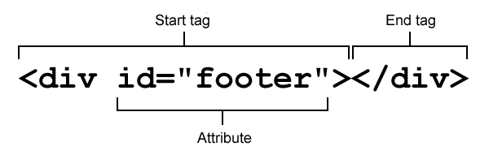
HTML Syntax
Most HTML tags come in pairs; an opening tag and a closing tag.
<, >, and & are special. http://character-code.com/
Content goes in between!

Slide 8
Special Characters
In assignments, I expect you to replace a few basic characters for typographical reasons:
“” curly quote &ldquo; &rdquo;
Em dash &mdash;
’ apostrophe &rsquo;
& ampersand &amp;

Slide 9
Some exceptions to the pair rule:
image
<img src="images/kittens.jpg" alt="kittens">
horizontal rule
<hr>
break
<p>611 N Woodlawn Ave<br>School of Informatics<br>Bloomington, IN 47408</p>

Slide 10
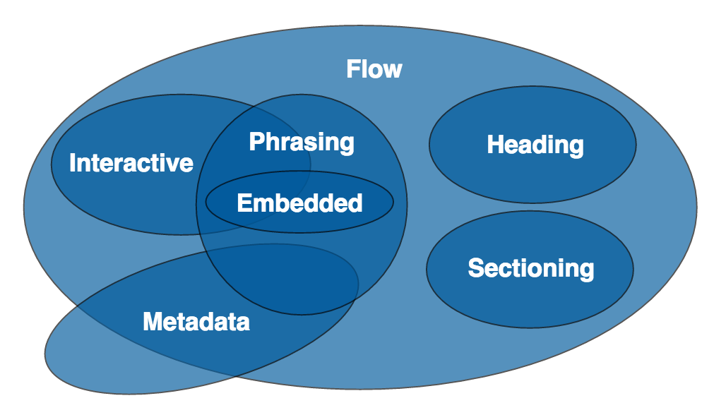
HTML tags surround expected content:
https://www.w3.org/TR/html/dom.html#kinds-of-content-flow-content

Slide 11
Metadata Content (The stuff you don’t see)
Found in the <head>. Sets up the presentation or behavior of the rest of the content, or links in additional resources.
<link></link>
<meta></meta>
<script></script>
<style></style>
<title></title>

Slide 12
Grouping Content * (Flow Content)
Found in the <body>. High-level elements represents structure & hierarchy of the content.
<h1></h1>
<p></p>
<ul><li></li></ul>
<div></div>
* Heading content and sectioning content are part of this group.
IMPORTANT: these elements force content to start on a new line.
NOTE: I will also refer to grouping content tags in class as “block” or “block-level” elements.

Slide 13
Phrasing Content
These text-level semantics are contained within structural HTML elements and surround only small parts of a document’s content, and thus NOT a structural unit like a paragraph or list.
<a> <b> <i> <em> <strong>
These elements appear within structural elements. For example: links, emphasized words or images.
And I will sometimes refer to these
as “inline” elements.

Slide 14
Embedded Content
Considered part of phrasing content, these elements import or insert other resources or media types into a document.
<audio>
<video>
<picture>
<svg>
IMPORTANT: These elements take up space, but do not by default create a new line in the document.

Slide 15
Comments in HTML
<!-- This is a comment. -->
<!--
Anything between the comment characters will not appear in the body of your site, but will appear in the source code.
-->
<!-- A comment providing information related to the page is a documentation comment *hint* *hint* -->

Slide 16
Writing Valid HTML
When the code used in a website is standard, DOES NOT use obsolete or deprecated tags or attributes, and is well-structured, we say it is VALID.
#TODO
In groups, identify a few of the deprecated / obsolete HTML tags and attributes that YOU SHOULD NOT USE THIS SEMESTER.

Slide 17
Quick Guide: HTML
Required
<!doctype html> identifies page as HTML
<html> wraps around your entire web page
<head> contains the stuff you DON’T see, but need
<body> contains the stuff you DO see
<meta charset=”utf-8”> makes sure all your characters are correct
<title>This title appears in browser tab</title>
title for your website/webpage
<link rel="stylesheet" type="text/css" href="css/styles.css">
links your HTML to your CSS (stylesheet)

Slide 18
Quick Guide: HTML
Content Structure
<p> paragraph – default text container
<h1>, <h2>...<h6> headlines in order of importance
<ul> bulleted list / unordered list
<ol> numbered list / ordered list
<li> list item
<table> define table
<tr> <td> <th> create a table: row / cell (column) / header
<a href=”http://www.iub.edu”>Link Name</a> link to other web pages
<img src=”images/iu-logo.jpg” alt=”Short description.”> place an image
Page structure
<div> box, division – for structure and/or design

Slide 19
References
HTML Validator
https://validator.w3.org/nu/
HTML Reference
https://developer.mozilla.org/en-US/docs/Web/HTML/Element
TIP:
The Online Resources page in Canvas is a good place to check if you can’t remember which lecture I mentioned which resource.

